Slide 1

Diabetes Prediction using Classification Methods
ICTCS 2023
Abhishek Karmakar
Sharik Gazi
Varsha Singh
Indian Institute of Information Technology, Allahabad

Slide 2

Abstract
When the body fails to produce a sufficient amount of insulin in the body, the sugar level in the blood- stream increases. This results in severe health and chronic issues. Diabetes complications cause kidney problems, heart strokes, nerve issues, and even more problems. Getting aid or precaution early can reduce the chance of Diabetes.
This work on Diabetes prediction can help in the improvement of human lifestyle. Our motive is to predict the outcome of whether or not the patient has Diabetes based on basic human features such as glucose level, blood pressure, insulin, BMI (Body Mass Index), number of pregnancies, skin thickness, diabetes pedigree function and age
To achieve our goal, we have used the famous Pima Indian type-2 Diabetes Mellitus Classification Dataset. In this paper, analysis is done using twelve machine learning algorithms and compared the results with others.

Slide 3
Introduction
The WHO (World Health Organization) survey shows that 95% of people have type-2 diabetes. According to WHO survey recorded from 2000 to 2019, the mortality rate by age has risen by 3% for diabetic people. It has been observed that people over 30 years of age are more likely to suffer from type- 2 diabetic disorder.
Our body needs glucose as its prime source of energy. Other than normal blood sugar levels in our body can lead to a metabolic disorder. The uncontrolled condition of this disease leads to the damage of nerves, eyes, and blood vessels and can cause neuropathy. The excess of glucose into the bloodstream causes a type-1 or type-2 diabetic chronic condition.
Over the past few years, in the list of global health problems, type-2 diabetes mellitus has been counted to be a major problem. Due to the gradual lifestyle change, diabetes has become a common disease. So early detection can be really helpful.

Slide 4
Our Target in this Paper
We analyzed the prediction of type-2 diabetes mellitus using twelve different machine learning algorithms like Logistic Regression, Support Vector Machine, Naive Bayes, K-Nearest Neighbours, Decision Tree, Random Forest, Gradient Boosting, Artificial Neural Network, Adaboost. Logitboost, Xgboost and K-Means evaluated them using accuracy, precision, recall, f1-score, support, ROC curve and AUC value.

Slide 5
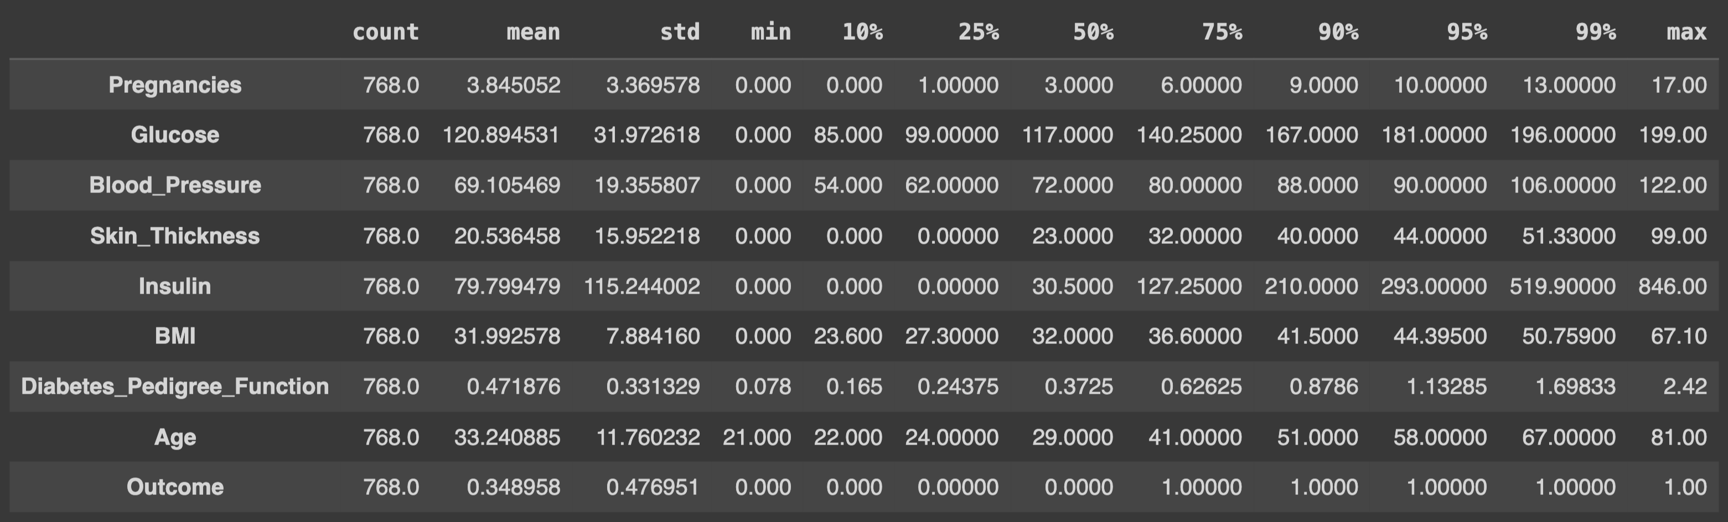
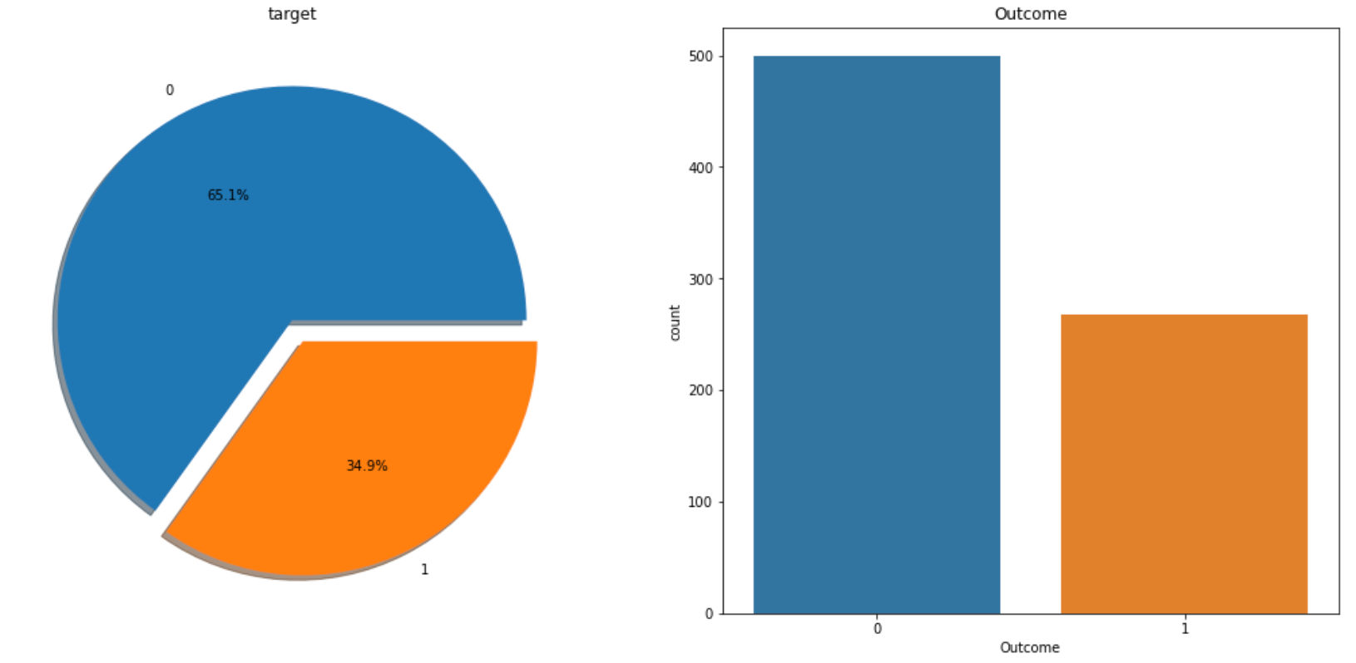
Data Description
The link to download the dataset is
https://data.world/data-society/pima-indians-diabetes-database
It is a type-2 diabetes disorder dataset. This dataset consists of the record of type-2 diabetic and non-diabetic people living in U.S. and Mexico.
The various health parameters examined were age, insulin, glucose, blood pressure level, number of pregnancies, skin thickness, Body Mass Index and diabetes pedigree function.
The record consists of 268 diabetic and 500 non-diabetic people.
PIMA Indian Diabetes Dataset
The statistical description of the numerical data for each feature is shown in the figure above

Slide 6
Data Description
The PIMA Indian Diabetes Dataset is widely used in research, but like many datasets, it has potential biases and limitations that can influence the conclusions drawn from it. Here are some potential biases present in the dataset:
Geographical Bias: The dataset is collected from Arizona, USA. Therefore, predictions made using this dataset may not be generalizable to populations from other geographical regions.
Ethnic Bias: The dataset is primarily focused on the PIMA Indian population. As a result, the findings may not necessarily extend to other ethnic or racial groups.
Potential Outcome Imbalance: The dataset contains a specific number of diabetic and non-diabetic individuals. With 268 diabetic and 500 non-diabetic records, there is an imbalance in the dataset. The sampling method used to select these individuals could introduce bias. This could potentially affect the performance of machine learning algorithms, making them more sensitive to predicting the majority class (in this case, non-diabetic).
Gender Bias: The dataset is a collection of all female having at least 21 years of age having type-2 diabetes. This bias found in the dataset as it lacks information of male patients.
PIMA Indian Diabetes Dataset

Slide 7
Data Description
Privacy considerations in data handling with respect to PIMA Indian Dataset:
Data Privacy and Anonymization: Despite the public availability and frequent use of the PIMA dataset, the individual identities remain paramount. In our utilization of this dataset, we adhered rigorously to best practices in data privacy, even though the dataset has undergone de-identification processes. Such steps are crucial in upholding the ethical standards associated with data-driven research and maintaining the trust of the communities under study.
Bias and Representation Concerns: The specificity of the PIMA dataset to the Pima Indian population introduces inherent biases that must be acknowledged. While this dataset provides valuable insights into the health and demographic trends of this particular group, it is imperative to approach the generalization of these results with caution. Findings from this dataset, though rigorous, are principally reflective of the Pima Indian community. Consequently, extrapolating these outcomes to wider ethnic or demographic contexts may not be directly applicable and requires careful consideration.
PIMA Indian Diabetes Dataset

Slide 8
Related Works
1.). Diabetes Prediction Studies:
Mentioned works in [4] used the Naokhali Medical College, Bangladesh dataset. [5] applied Principal Component Analysis (PCA) on hospital physical examination data from Luzhou, China. [6] and [7] discussed various approaches for diabetes prediction.
2.). Focus on Pima Indian Diabetes Dataset:
[8] Recent research achieved accuracies on Pima dataset: Logistic Regression and Support Vector Machine: 81.16%. KNN: 77.92%. Decision Tree: 77.07%. Random Forest and Neural Network: 77.92% .
[9] Another study reported accuracies: Logistic Regression: 77.5%. Support Vector Machine: 77.9%. KNN: 76%. Decision Tree: 75.8%. Random Forest: 79.7%. Gradient Boosting: 79.2%. Artificial Neural Network: 78.4%.
3.). Additional Insights on Pima Dataset:
[10] had achieved 77% accuracy using Logistic Regression and KNN.
[11] obtained 78.8% accuracy through an artificial neural network.
[12] highlighted KNN with 83.76% accuracy.
[13] reported high accuracies: Support Vector Machine: 89%. KNN: 88%. Artificial Neural Network: 86%.
[14] showcased Naïve Bayes and Decision Tree: Naïve Bayes: 79.56%. Decision Tree: 76.95%.
[15] used Neural Network and achieved 88.41% accuracy.
[16] reported accuracies: Decision Tree: 78.64%. Gradient Boosting: 66.40%. Adaboost: 77.86%. Logitboost: 77.49%.
[17] showed accuracies: J48: 78.95%. CART: 78.64%.
[18] reported Support Vector with 78% accuracy.
[19] used three algorithms: Naïve Bayes: 76.30%. Support Vector: 65.10%. Decision Tree: 73.82%.
[20] applied nine algorithms: Extreme Gradient Boosting: 80.52%. Gradient Boosting: 76.62%. Multinomial Naïve Bayes: 68.83%. Gaussian Naïve Bayes: 80.52%. Logistic Regression: 81.92%. Support Vector: 83.12%. KNN: 81.82%. Decision Tree: 77.92%. Neural Network: 84.42%. Adaboost Classifier: 76.62%.
[21] presented accuracies for decision tree, random forest, and Naïve Bayes: All features: 74.78%, 79.57%, 78.67%. 3 features: 75.22%, 75.22%, 79.13%. 5 features: 75.65%, 73.91%, 77.83%.

Slide 9
Proposed Work
Our Work Focuses on diabetes classification on PIMA Indian Dataset evaluated using accuracy, precision, recall, f1-score, support, ROC curve and AUC value.
Prediction of type-2 diabetes mellitus using the following 12 different machine learning algorithms -
Logistic Regression
Support Vector Machine
Naive Bayes
K-Nearest Neighbours
Decision Tree
Random Forest
Gradient Boosting
Artificial Neural Network
Adaboost
Logitboost
Xgboost
K-Means
Impressive exploration of different machine learning algorithms for diabetes prediction.
To perform a correct classification, the most important step which is to be performed is data pre-processing. After handling the improper data, balancing the dataset, normalizing the data, splitting it into test and train, then the data is fed into the data modelling section.

Slide 10
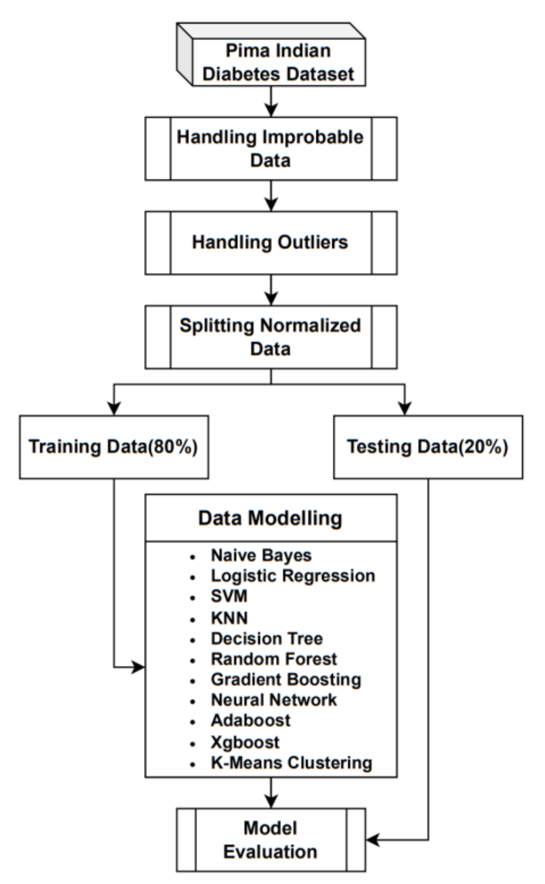
Outline of Overall Methodology

Slide 11
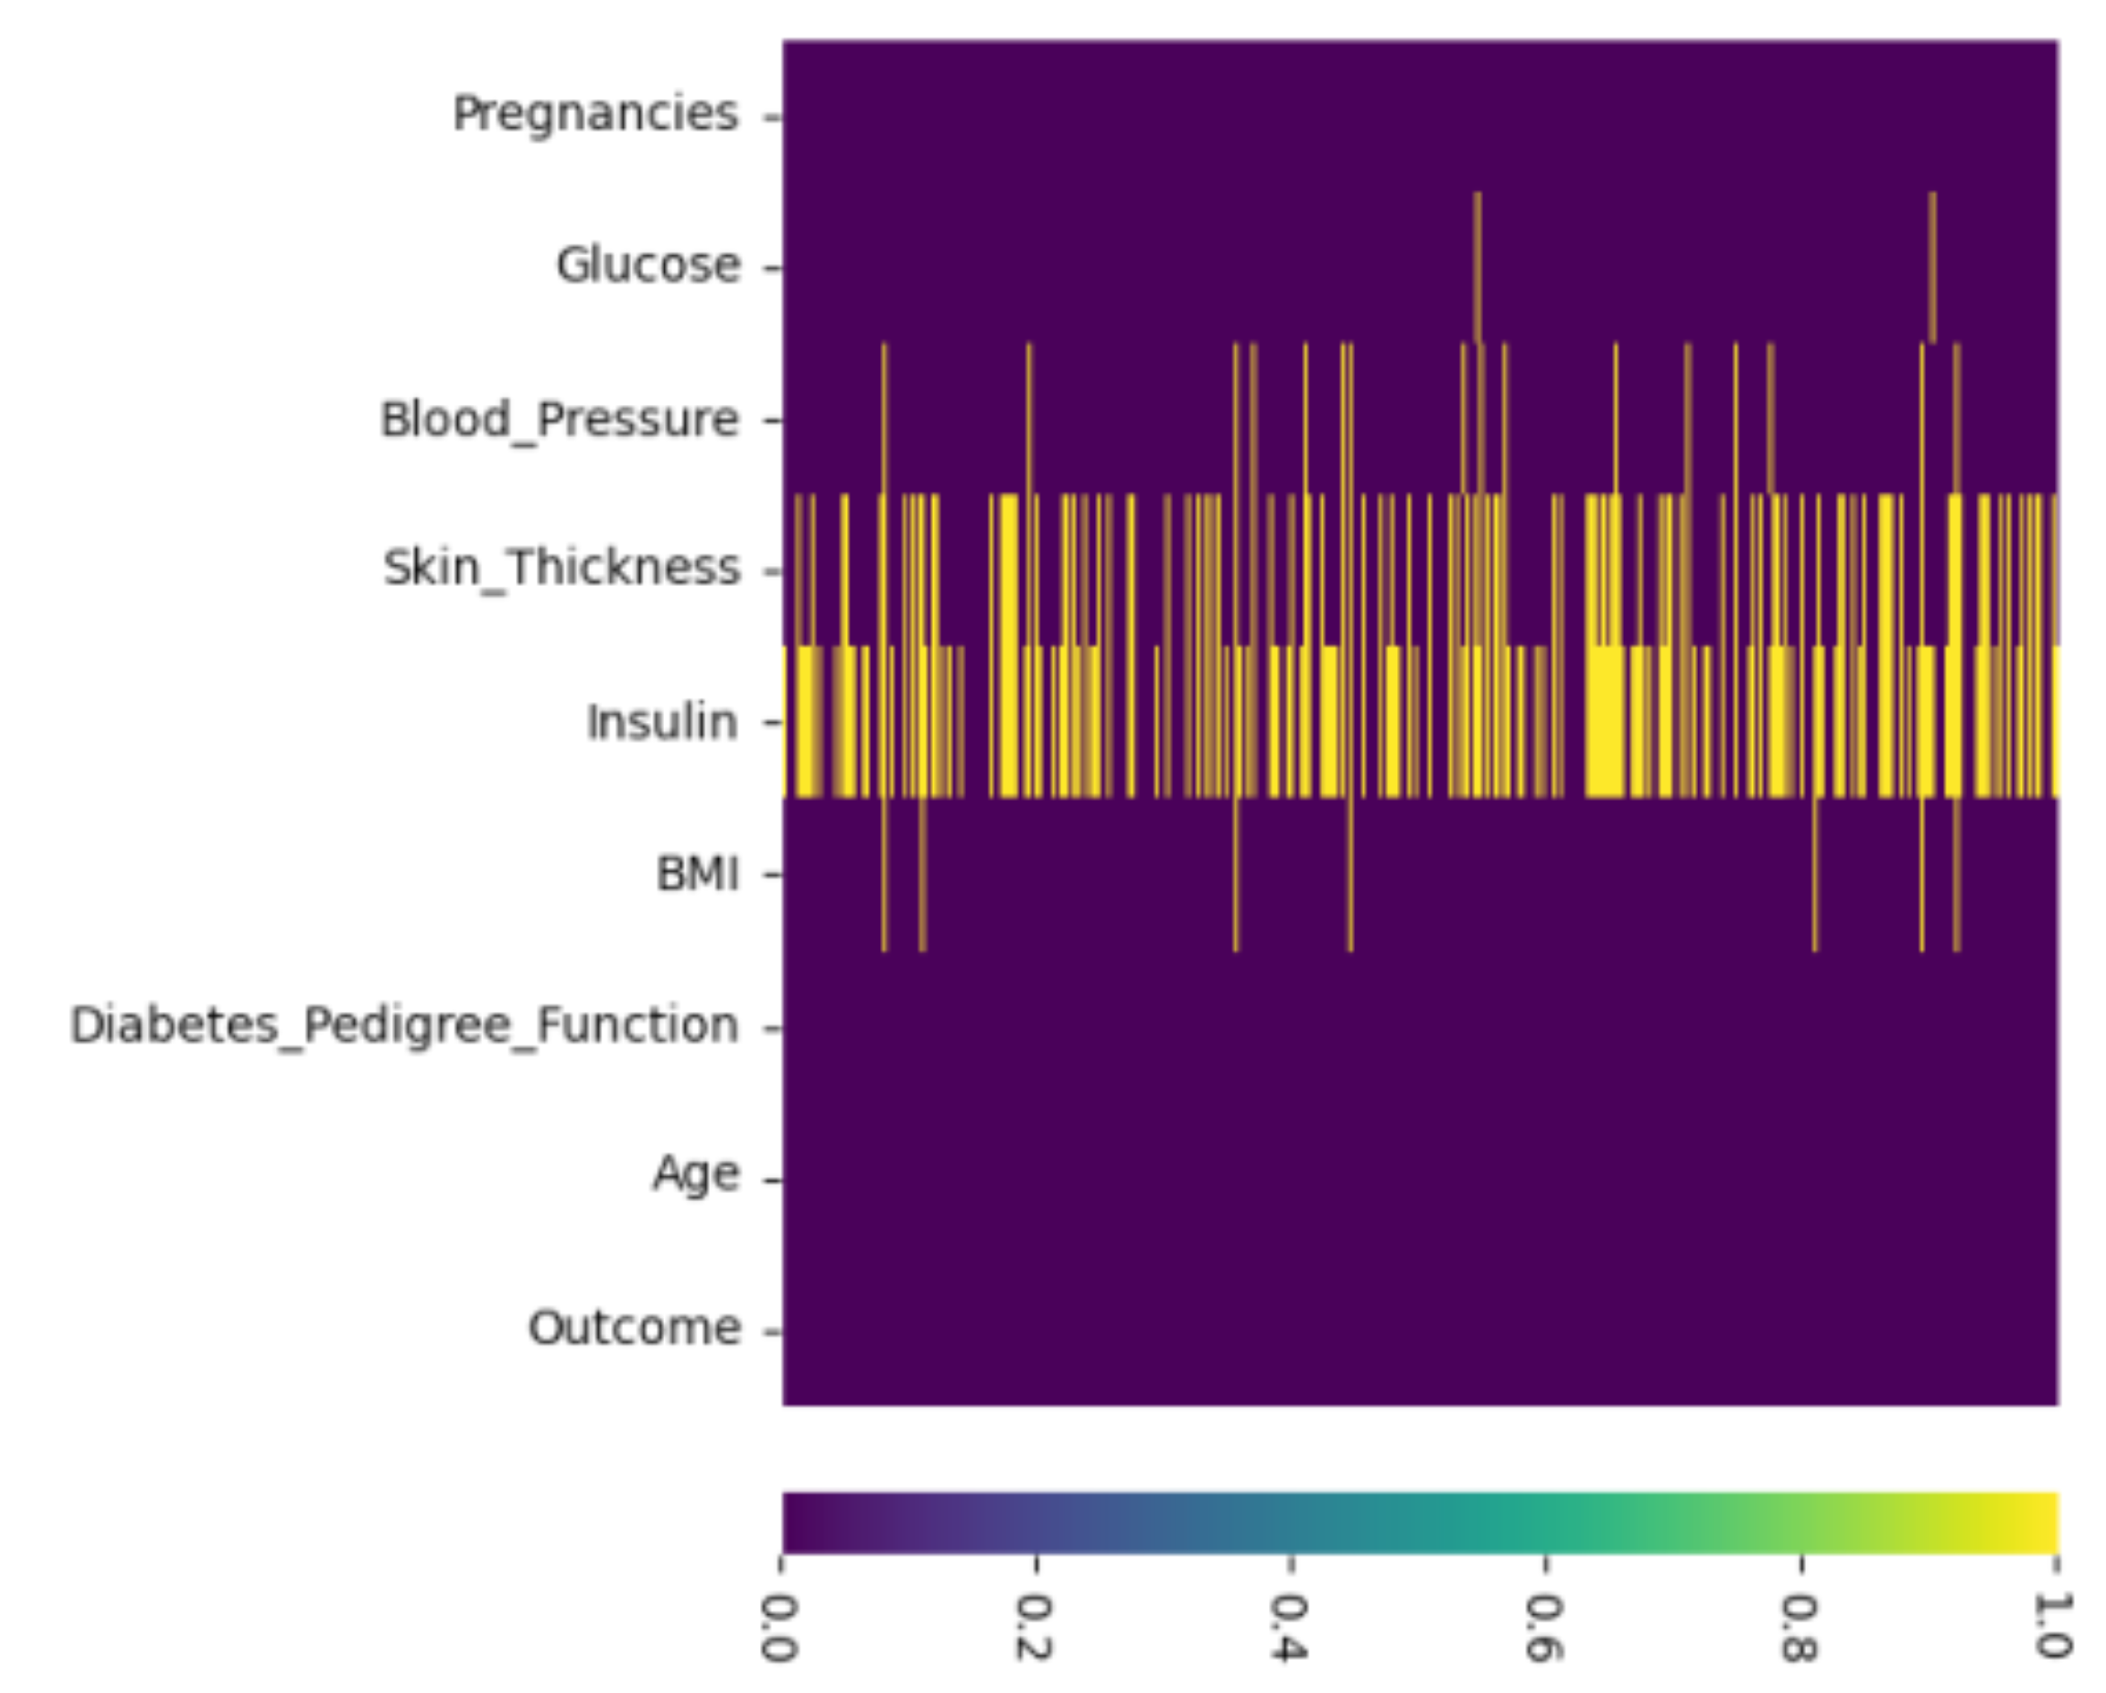
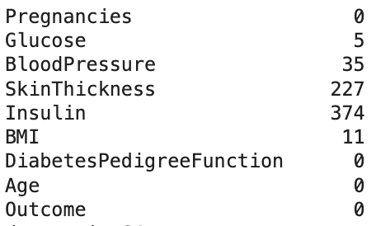
Handling Improbable Data
Data pre-processing is a technique which the data is prepared to enhance the model performance. In the given dataset there are attributes such as glucose level, blood pressure level, skin thickness and BMI which cannot be zero. So as in for the first step we had replaced all such insignificant values to Nan (or Null).
Figure : Samples consisting of the insignificant values

Slide 12
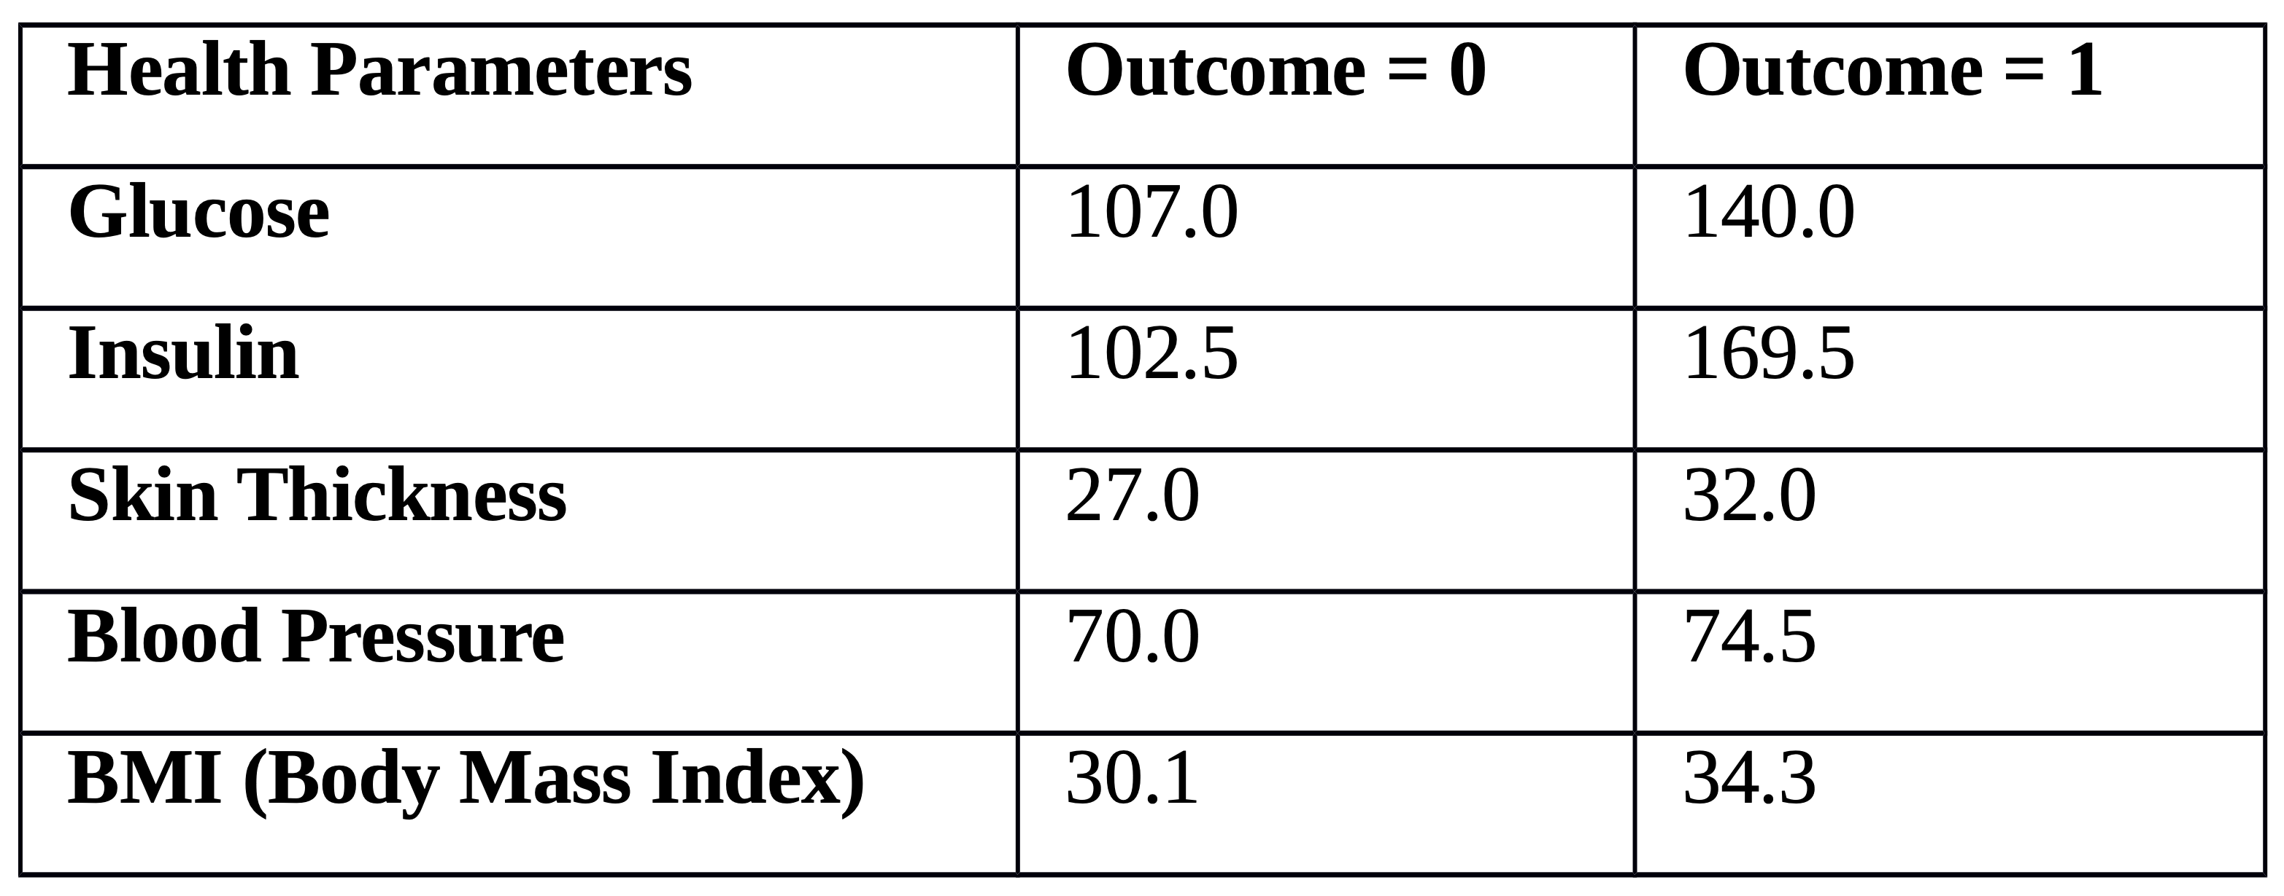
Handling Improbable Data
The dataset now consists of the Nan values, also it contains outliers. So the best way to replace all the Nan values is with median of the data. For each attribute the Nan values has been replaced with the median value pertaining to diabetic or non-diabetic patient.
For example, the median glucose value for non-diabetic people is 107 whereas for diabetic people the median value is 140.
Table: Shows median value for the category of diabetic and non-diabetic people.

Slide 13
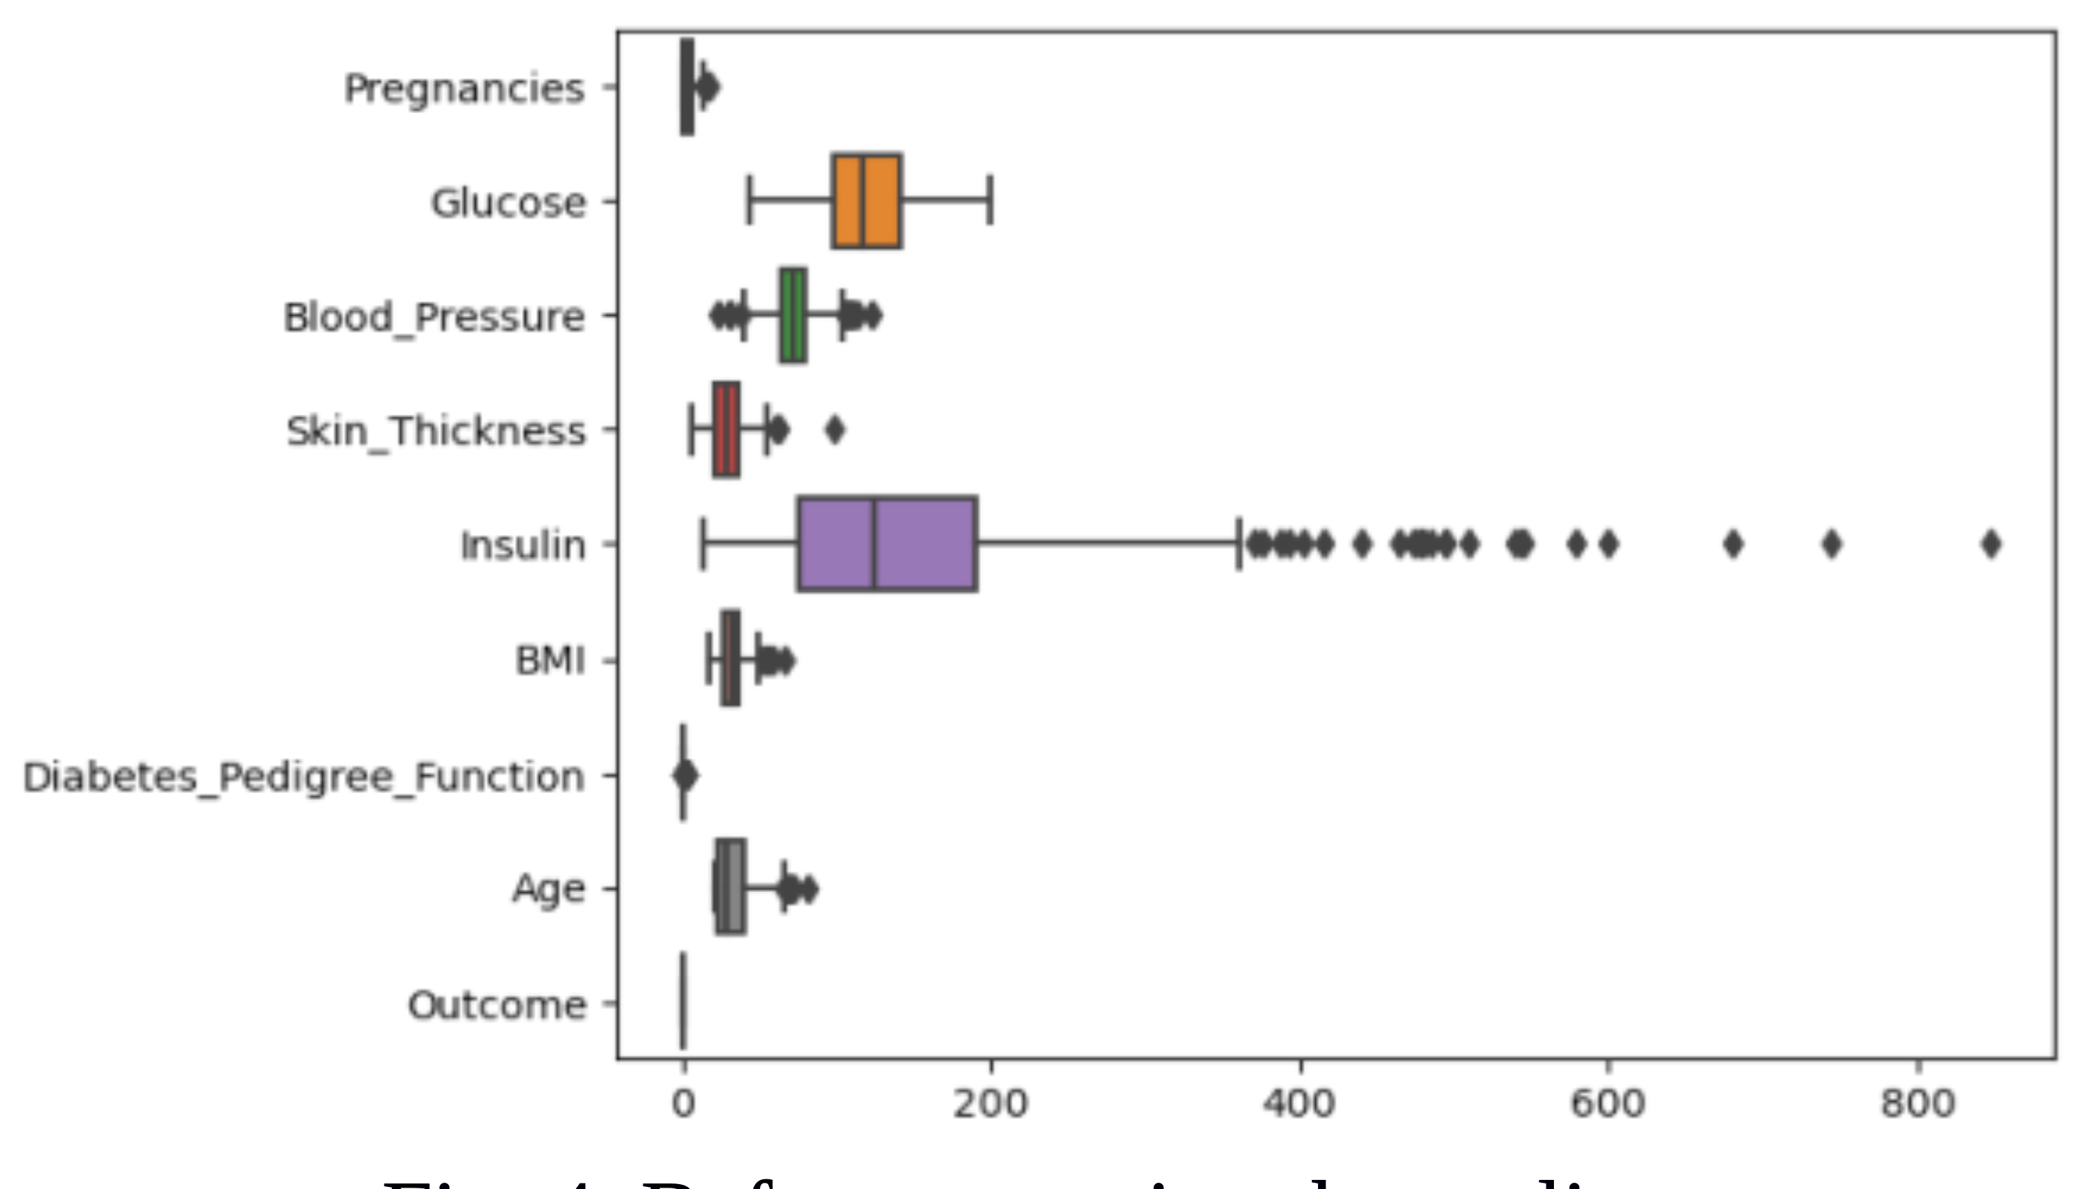
Handling Outliers
The spread of any kind of distribution of the data is tends to decrease at the extremes. The middle half of the data which lies within the second and third quartiles are called as interquartile range. This IQR (Interquartile Range) method is used for outlier detection as next step of the process.
The Extreme values are replaced with the (Q1 - 1.5 IQR) and (Q3 + 1.5 IQR) values.
IQR is the range between the first and the third quartiles namely Q1 and Q3: IQR = Q3 – Q1. The data points which fall below Q1 – 1.5 IQR or above Q3 + 1.5 IQR are outliers.

Slide 14
Splitting the Normalized Data
The data has been normalized using min-max normalization technique and then divided into training set (80%) and testing set (20%) in the ratio 4:1.

Slide 15
Handling Imbalance Data
In order to balance the training dataset SMOTE (Synthetic Minority Over-sampling Technique) has been used to prevent the diabetic and non-diabetic biased learning of the model.

Slide 16
Models Chosen for training
The training data has been fed into the following models:-
Naïve Bayes: Gaussian Naïve Bayes, Multinomial Naïve Bayes and Complement Naïve Bayes models has been used to train the model. For 10 fold cross validation with var_smoothing parameter value to be 0.01 for GaussianNB() obtains accuracy of 87.66%. MutinomialNB() shows an accuracy of 82.46% and ComplementNB() shows an accuracy of 80.51%. Gaussian Naïve Bayes shows us the higher accuracy with an AUC value of 80.6.
Logistic Regression: A 10-fold cross validation has been performed on this model, it was seen that parameters 'C': 0.001, 'max_iter': 100, 'penalty': 'l2' gave us an optimal accuracy of 89.61% with AUC value of 87.8
Support Vector Machine: For a 5-fold cross validation and with most optimal parameters 'C': 1, 'gamma': 0.001, 'kernel': 'rbf', the model gave an accuracy of 88.96% with AUC value to be 87.3
K-Nearest Neighbors: For the nearest neighbors to be 8, the model gave us an accuracy of 88.96% with AUC value of 87.9
Decision Tree: For the most optimal parameters criterion = 'entropy', max depth=20, max features=6, min samples leaf = 4, the model gave an accuracy of 88.31% with AUC value to be 86.2

Slide 17
Models Chosen for training
The training data has been fed into the following models:-
Random Forest: The model gave us an accuracy of 90.90% for parameter values – criterion = 'entropy', max depth = 60, max features = 8, min samples leaf = 2, n_estimators = 40 with AUC value 88.8%
Gradient Boosting: For the parameters n_estimators = 55, learning rate = 0.25, max depth = 1, loss = 'log_loss', the model gave an accuracy of 91.55% with AUC value of 89.7%.
Neural Network: The 3-Dense layers consists of 30 units,10 units and 1 unit. The first two layers consists of relu as activation function where as the last layer consist of sigmoid as activation function considering loss function to be binary cross entropy and the optimizer be adam version of the stochas- tic gradient descent. The model gave an accuracy of 84.41% with AUC value to be 82.8%.
Adaboost: For n_estimators=30, the model shows us an accuracy of 89.61% with AUC value to be 88.3%.
Logitboost: For n_estimators=16, the accuracy obtained was 90.25% with AUC value of 90%.
Xgboost: For the parameters 'min_child_weight': 9, 'max_depth': 19, 'learn- ing_rate': 0.1105, 'gamma': 0.8, the model accuracy comes out to be 90.90% with AUC value of 89.9%.
K-Means Clustering: The model has been trained for 2 clusters for which the accuracy obtained is 87.66% with AUC value of 87.8%.

Slide 18
Results
Models | Accuracy | F1-score |  | AUC
 |  | outcome=0 | outcome=1
Naïve Bayes | 87.66 | 0.91 | 0.81 | 0.806
Logistic Regression | 89.61 | 0.93 | 0.83 | 0.878
Support Vector Machine | 88.96 | 0.92 | 0.82 | 0.873
K-Nearest Neighbours | 88.96 | 0.92 | 0.82 | 0.879
Decision Tree | 88.31 | 0.92 | 0.81 | 0.862
Random Forest | 90.90 | 0.94 | 0.85 | 0.888
Gradient Boosting | 91.55 | 0.95 | 0.86 | 0.89.7
Neural Network | 84.41 | 0.89 | 0.76 | 0.828
Adaboost | 89.61 | 0.92 | 0.83 | 0.883
Logitboost | 90.25 | 0.93 | 0.85 | 0.90
Xgboost | 90.90 | 0.93 | 0.85 | 0.899
K-Means | 87.66 | 0.91 | 0.80 | 0.878

Slide 19
Comparison Table
ML Algorithms | Paper[8] | Paper[9] | Paper[10] | Paper[11] | Paper[12] | Paper[13] | Paper[14] | Paper[15] | Paper[16] | Paper[17] | Paper[18] | Paper[19] | Paper[20] | Paper[21] | Our work
Naïve Bayes | -- | -- | -- | -- | -- | -- | 79.56 | -- | -- | 79.56 | -- | 76.30 | 68.83 and 80.52 | 77.83 | 87.66
Logistic Regression | 81.16 | 77.5 | 77 | -- | -- | -- | -- | -- | -- | -- | -- | -- | 81.92 | -- | 89.61
Support Vector Machine | 81.16 | 77.9 | -- | -- | -- | 89 | -- | -- | -- | -- | 78 | 65.10 | 83.12 | -- | 88.96
K-Nearest Neighbours | 77.92 | 76 | 77 | -- | 83.76 | 88 | -- | -- | -- |  | -- | -- | 81.82 | -- | 88.96
Decision Tree | 72.07 | 75.8 | -- | 78.17 | -- | -- | 76.95 | -- | 78.64 | 76.95 and 78.64 | -- | 73.82 | 77.92 | 75.65 | 88.31
Random Forest | 77.92 | 79.7 | -- | -- | -- | -- | -- | -- | -- | -- | -- | -- | 75.32 | 79.57 | 90.90
Gradient Boosting | -- | 79.2 | -- | -- | -- | -- | -- | -- | 66.40 | -- | -- | -- | 76.62 and 80.52 | -- | 91.55
Neural Network | 77.92 | 78.4 | -- | -- | -- | 86 | -- | 88.41 |  | -- | -- | -- | 84.42 | -- | 84.41
Adaboost | -- | -- | -- | -- | -- | -- | -- | -- | 77.86 | -- | -- | -- | 76.62 | -- | 89.61
Logitboost | -- | -- | -- | -- | -- | -- | -- | -- | 77.49 | -- | -- | -- | -- | -- | 90.25
Xgboost | -- | -- | -- | -- | -- | -- | -- | -- | -- | -- | -- | -- | -- | -- | 90.90
K-Means | -- | -- | -- | -- | -- | -- | -- | -- | -- | -- | -- | -- | -- | -- | 87.66

Slide 20
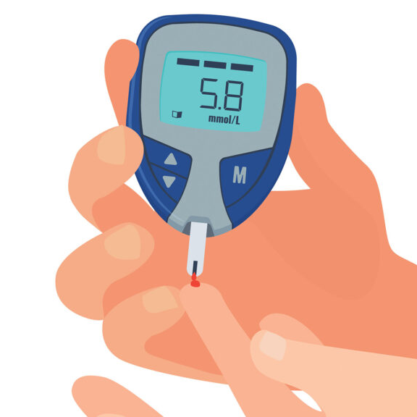
Conclusion
In this paper work we had tried to predict the type-2 diabetes using the human parameters through the implementation of twelve machine learning algorithms.
It can be seen that the bagging and boosting techniques yield better output compared to pure models.
Gradient Boosting has provided the best result compared to any other algorithm.
The PIMA dataset encapsulates attributes of individuals from both the US and Mexico, offers a rich repository of salient features, enhancing its real-world applicability. Integrating additional data from diverse healthcare settings can foster the development of a more robust and generalizable predictive model. Such advancements can significantly support early risk assessments, enabling timely preventive measures for individuals pre-disposed to Type-2 diabetes.

Slide 21
References
https://www.who.int/news-room/fact-sheets/detail/diabetes, last accessed 12/12/22.
https://www.nature.com/articles/nrdp201519#Abs1, last accessed 12/12/22.
Kowsher, Md, et al. "Prognosis and treatment prediction of type-2 diabetes using deep neural network and machine learning classifiers." 2019 22nd International Conference on Computer and Information Technology (ICCIT). IEEE, 2019.
Zou, Quan, et al. "Predicting diabetes mellitus with machine learning techniques." Frontiers in genetics 9 (2018): 515.
Lai, Hang, et al. "Predictive models for diabetes mellitus using machine learning techniques." BMC endocrine disorders 19.1 (2019): 1-9.
Sarwar, Muhammad Azeem, et al. "Prediction of diabetes using machine learning algorithms in healthcare." 2018 24th international conference on automation and computing (ICAC). IEEE, 2018.
Mishra, Shubham, A. Vinod, and S. Kala. "Machine Learning Approaches for Type-2 Diabetes Software Predictor." 2022 International Conference on Innovative Trends in Information Technology (ICITIIT). IEEE, 2022.
Barhate, Rahul, and Pradnya Kulkarni. "Analysis of classifiers for prediction of type ii diabetes mellitus." 2018 Fourth International Conference on Computing Communication Control and Automation (ICCUBEA). IEEE, 2018.
Singh, Varsha, and A. K. Mishra, “A genetic algorithm for k-mean clustering,” International Journal of Emerging Technologies in Computational and Applied Sciences, vol. 7, no. 4, pp. 359–364, 2013.
Singh, Varsha, Singh, Vijai, and U. S. Tiwary, “Clustering using genetic algorithm: A collaborative performance analysis,” in 2023 10th International Conference on Computing for Sustainable Global Development (INDIACom). IEEE, 2023, pp. 407–412.
Patra, Radhanath. "Analysis and prediction of Pima Indian Diabetes Dataset using SDKNN classifier technique." IOP Conference Series: Materials Science and Engineering. Vol. 1070. No. 1. IOP Publishing, 2021.
Kaur, Harleen, and Vinita Kumari. "Predictive modelling and analytics for diabetes using a machine learning approach." Applied computing and informatics (2020).
Iyer, Aiswarya, S. Jeyalatha, and Ronak Sumbaly. "Diagnosis of diabetes using classification mining techniques." arXiv preprint arXiv:1502.03774 (2015).
Ashiquzzaman, Akm, et al. "Reduction of overfitting in diabetes prediction using deep learning neural network." IT convergence and security 2017. Springer, Singapore, 2018. 35-43.
Sen, S.K. and Dash, S. (2014) Application of Meta Learning Algorithms for the Prediction of Diabetes Disease. International Journal of Advance Research in Computer Science and Management Studies, 2, 396-401
Iyer, A., Jeyalatha, S. and Sumbaly, R. (2015) Diagnosis of Diabetes Using Classification Mining Techniques. International Journal of Data Mining & Knowledge Management Process (IJDKP), 5, 1-14. https://doi.org/10.5121/ijdkp.2015.5101
Kumari, V.A. and Chitra, R. (2013) Classification of Diabetes Disease Using Support Vector Machine. International Journal of Engineering Research and Applications (IJERA), 3, 1797-1801.
Sisodia, Deepti, and Dilip Singh Sisodia. "Prediction of diabetes using classification algorithms." Procedia computer science 132 (2018): 1578-1585.
Mahabub, Atik. "A robust voting approach for diabetes prediction using traditional machine learning techniques." SN Applied Sciences 1.12 (2019): 1-12.
Chang, Victor, et al. "Pima Indians diabetes mellitus classification based on machine learning (ML) algorithms." Neural Computing and Applications (2022): 1-17.

Slide 22
Thank You !!

